Slide 1
SIVA RAJESH SIGIREDDY
Final project

Slide 2

KEY LOGGER SECURITY

Slide 3
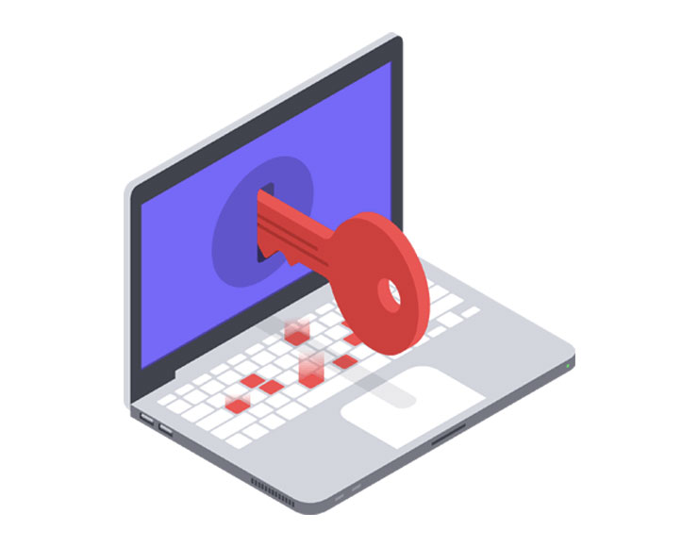
AGENDA
Keyloggers are malware that record keystrokes to steal sensitive information. They can be installed via infected software, phishing emails, malicious files, or compromised cloud programs, and can also capture screenshots and track browser activity. To protect against keyloggers, use strong antivirus software, practice safe browsing, avoid suspicious emails, and keep software updated to patch vulnerabilities.
TYPES OF KEY LOGGERS
1. Software keyloggers
2. Hardware keyloggers
3. Mobile keyloggers

Slide 4

PROBLEM STATEMENT:
Keyloggers are a genuine danger to clients and the clients' information, which is considered exploitative movement. The problem statement is that the keyloggers can be detected using antiviruses. Installation of hardware keyloggers is difficult without the knowledge of the owner of the system.
Keyloggers can be detected using antiviruses. Installation of hardware keyloggers is difficult without the knowledge of the owner of the system. The solution to the above existing problem is that we can build a software keyloggers instead of hardware keyloggers.
The problem statement is that the keyloggers can be detected using antiviruses. Installation of hardware keyloggers is difficult without the knowledge of the owner of the system. The solution to the above existing problem is that we can build a software keyloggers instead of hardware keyloggers.

Slide 5
PROJECT OVERVIEW
1. Ensure Python or an IDE is installed on your computer.
2. Install the pynput library using the command: pip install pynput.
3. Install the jsons library using the command: pip install jsons.
4. After installing Python and pynput, create a file named Keylogger.py and copy the Python script into this file.
5. Running the script will not open a new window. Instead, a Keylogger.txt file will appear in the script’s directory. This script uses pynput to log keystrokes into a text file. You can open Keylogger.txt to view all keystrokes recorded on the target computer.

Slide 6
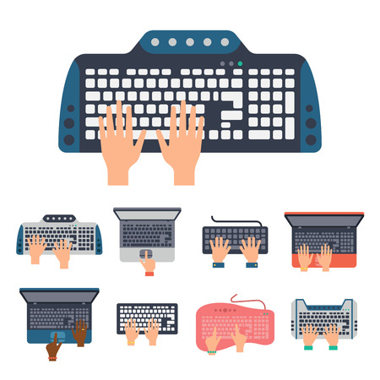
WHO ARE THE END USERS..?
The term "end user" refers to the consumer of a good or service, typically possessing unique know-how specific to consumers. An end user is anyone in your organization who utilizes software and hardware assets to carry out their job responsibilities.
External attacks can manifest in various forms. Two primary cyberattacks to be vigilant about are:
1. Malware
2. Phishing
End users are responsible for safeguarding the information resources they have access to.

Slide 7
YOUR SOLUTION AND ITS PROPOSITION
Organizations often sought cybersecurity software only in response to attacks. However, with cyber attacks increasingly prevalent in the media, many organizations are now taking proactive measures to safeguard their data and valuable assets. Rather than immediately presenting features, it's important to first identify the specific pain points of each prospect and then tailor the conversation to address the particular risks that concern them the most . Depending upon the prospect, your value proposition might to speak : 1.Financial Risk 2.Reputational Risk 3.Legal Risk 4.Compliance Risk

Slide 8
HOW KEYLOGGERS ATTACKS YOUR DEVICE
To gain access to your device, a keylogger has to be installed inside in it or, in the case of a hardware keylogger physically connected to your computer. There are a few different ways for keyloggers attack your device
1. Spear phising
2. Drive-by download
3. Torjan horse
Problems caused by keyloggers :-
1. Unknown processes consuming computing power
2. Delays during typing
3. Applications freeze randomly

Slide 9
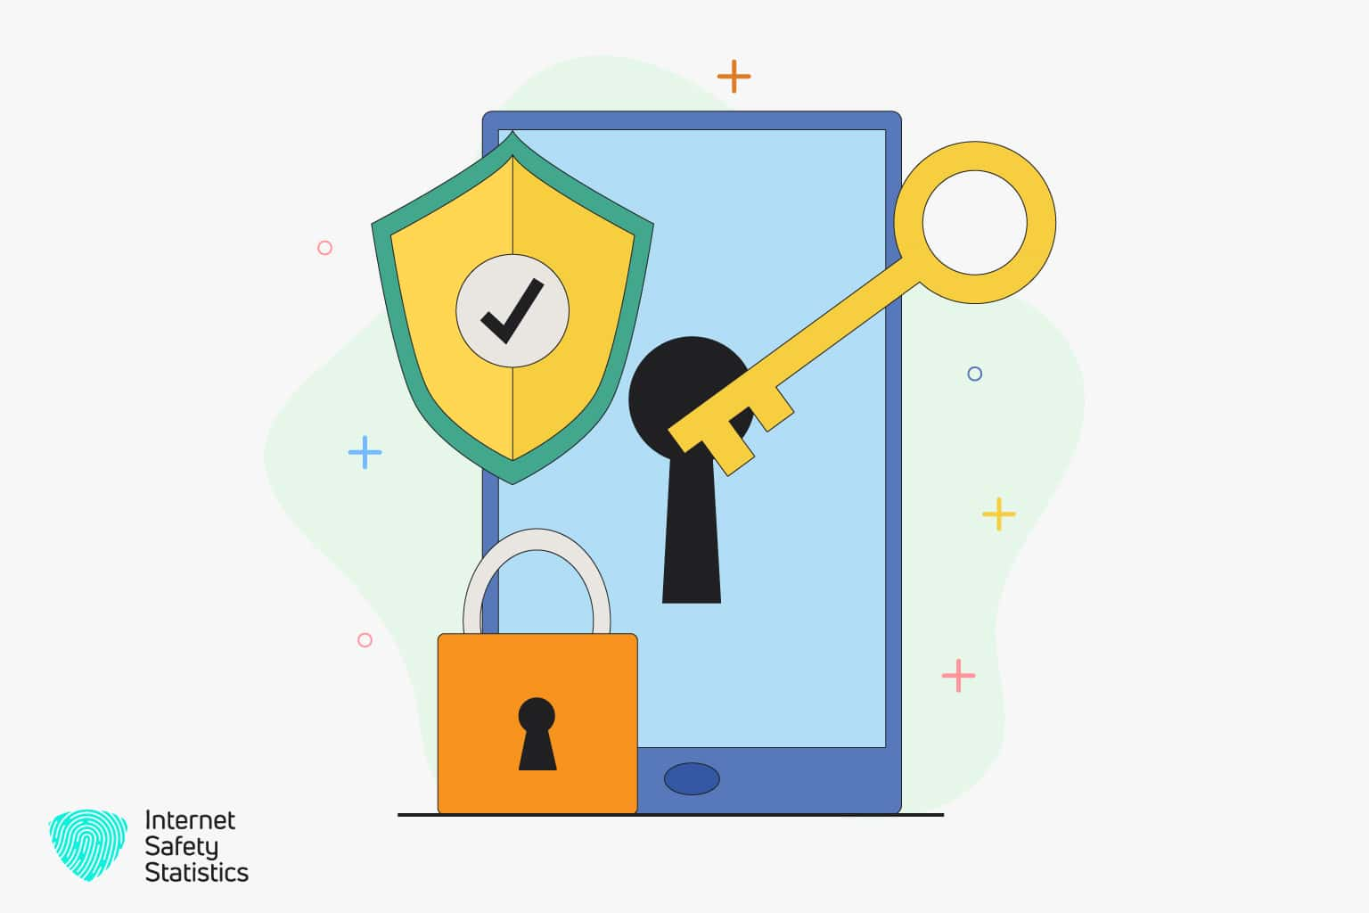
HOW TO DETECT A KEYLOGGER
Here's how to access your extensions in some of the most common browsers:
Safari: Choose "Preferences" from the Safari menu, then click on "Extensions."
Chrome: Enter "chrome://extensions" in the address field.
Opera: Select "Extensions," then choose "Manage Extensions."
Firefox: Type "about : addons " in the address field.
Microsoft Edge: Click on "Extensions" in your browser menu.
Internet Explorer: Go to the Tools menu and select "Manage add-ons.""

Slide 10
CONCLUSION
A keylogger, whether in the form of software or hardware, is a surveillance tool capable of capturing every keystroke made.
It has the ability to record various forms of communication such as instant messages and emails, as well as any information typed using the keyboard at any given time.
Keyloggers pose a serious threat to both individuals and organizations, potentially causing substantial harm if not identified and mitigated.
Therefore, comprehending their functionality, infiltration techniques, and associated risks is essential for ensuring digital security

Slide 11
PROJECT LINK
https://github.com/sivarajeshsigireddy/rajeshproject.git

